Slide 1
ICT Testing Baseline Portfolio
CSUN 2024
Presented by U.S. Access Board and GSA

Slide 2
Setting the Stage
ICT Baseline for Web (ictbaseline.access-board.gov/)
“Co-owned” by Access Board and General Services Administration (GSA)
The ICT Testing Baseline for Web is a Best Practice of the Federal CIO Council Accessibility Community of Practice (ACOP).
Federal agencies are encouraged to utilize the Baseline for Web in their efforts to test web content for Section 508 conformance.
Notes:
ICT Baseline for Web: ictbaseline.access-board.gov/

Slide 3
Agenda
Section 508 conformance testing challenges
Solution: ICT Baselines
How the Baseline applies to you
What’s New?

Slide 4
ICT Accessibility Testing – Challenges
Testing is necessary to determine whether ICT conforms to the Section 508 Standards
Testing has its challenges:
Interpretation of standards vary
Variety of test methodologies
Manual – can test all requirements but slow
Automated – limited in testing capability but fast
Hybrid
Inconsistent test results

Slide 5
Test Report Questions
Who did the testing?
If we tested the same product, would we get the same results?
Can we trust that these results are accurate?
Don’t know/No?
Multiple agencies testing the same product
Conflicting test results confuse product vendors

Slide 6
Recent Recommendations to use the Baseline
From OMB’s M-24-08:
Agencies should utilize the ICT Testing Baseline for Web to assist in determining web content conformance with Section 508 standards.
From GSA’s FY23 Governmentwide Assessment:
Agencies should follow the ICT Testing Baseline for Web to adopt or create a standard enterprise testing methodology to increase Section 508 conformance, provide greater ability for information sharing, and allow for more consistent reporting across government.
Notes:
OMB’s M-24-08: https://www.whitehouse.gov/omb/management/ofcio/m-24-08-strengthening-digital-accessibility-and-the-management-of-section-508-of-the-rehabilitation-act/
From GSA’s FY23 Governmentwide Assessment: https://www.section508.gov/manage/section-508-assessment/2023/recommendations/

Slide 7
The ICT Testing Baseline Portfolio – The Solution
Section 508/WCAG 2.0 AA
What to Test
ICT Testing Baseline
Establishes the foundation for consistent test results
Will eventually include Baselines for all ICT covered by Section 508
Completed: Web
Draft: Electronic Documents
Planned: software, hardware, etc.

Slide 8
Baseline-Aligned Test Process
ICT Testing Baseline
HOW to test (Test Tools)
Test Process
Where YOU come in!
Where YOU come in!

Slide 9
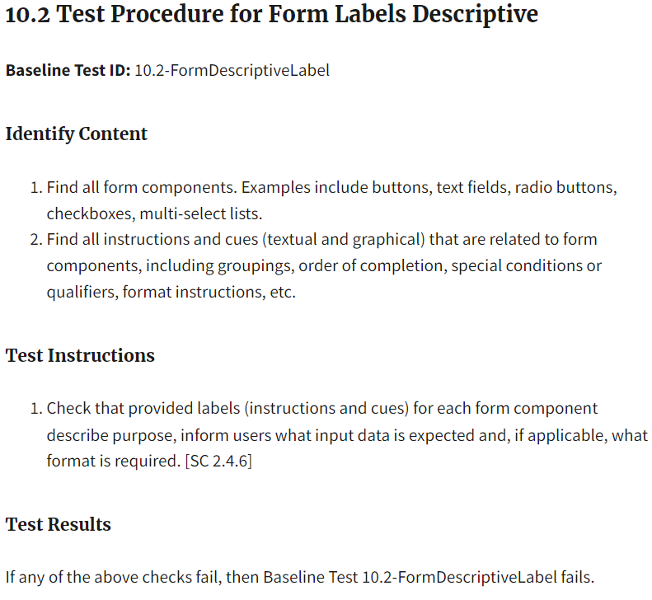
What exactly is the Baseline?
24 groups of concepts to test
Keyboard Access, Forms, Images, Contrast, Tables, etc.
Within each group are specific test procedures containing:
Identify Content
Test Instructions
Test Results
Tool agnostic; NOT a test process
ICT Baseline for Web
ictbaseline.access-board.gov/
Notes:
ICT Baseline for Web
(ictbaseline.access-board.gov/)
“Co-owned” by Access Board and GSA
Federal CIO Council Accessibility Community Of Practice (ACOP) Best Practice

Slide 10
Updates to Web Baseline
Release planned for FY24 Q2
Image tests defer to author to determine meaningful or decorative images
New test for User Controls covers SC 4.1.2 more accurately
Incorporation of WCAG 2.2 Understanding articles and Parsing
All Baselines single page

Slide 11

Alignment Framework-You’re Involved!
To be considered Baseline-Aligned, test processes (tools and methodology) must demonstrate alignment.
Test Cases (399 specific test cases identified to date)
Cover pass | fail | not applicable for each check
Expected test result
Describe reasoning for result
Baseline Alignment Reporting Tool
Enter your test process results for test cases
Results will determine level of alignment to the Baseline
Baseline Alignment Framework (for Web)
section508coordinators.github.io/baselinealignment/
Test cases are still in development
Plan for majority of test cases to be complete by end of 2024

Slide 12
New: Baseline for Documents
Planned release in FY24 Q2
SMEs leading development: Accessible Electronic Documents Community of Practice (AED COP)
Based on the Baseline for Web template
Same 508 requirements as Web (except 4 WCAG SCs)
Edited terminology for documents
Covers any document format
Office, PDF, etc.
What an alignment framework may look like is under discussion
AED COP to review and update existing format-specific guidance for alignment (some tests may be marked as N/A)

Slide 13
Section 508 Resources
Revised 508 Standards
www.access-board.gov/ict
ICT Testing Baseline for Web
Section508.gov - A one-stop for Section 508 information and resource for agencies
Training (…/training)
Create Accessible Content (…/create)
Testing (…/test)
Notes:
Revised 508 Standards
www.access-board.gov/ict
ICT Testing Baseline for Web
Section508.gov - A one-stop for Section 508 information and resource for agencies
Training (…/training)
Create Accessible Content (…/create)
Testing (…/test)

Slide 14
Contact Us
U.S. Access Board
202-272-0080 ext. 3
508@access-board.gov|access-board.gov
GSA IT Accessibility Program
Section.508@gsa.gov | section508.gov
Notes:
U.S. Access Board
202-272-0080 ext. 3
508@access-board.gov|access-board.gov
GSA IT Accessibility Program
section.508@gsa.gov | section508.gov

Slide 15
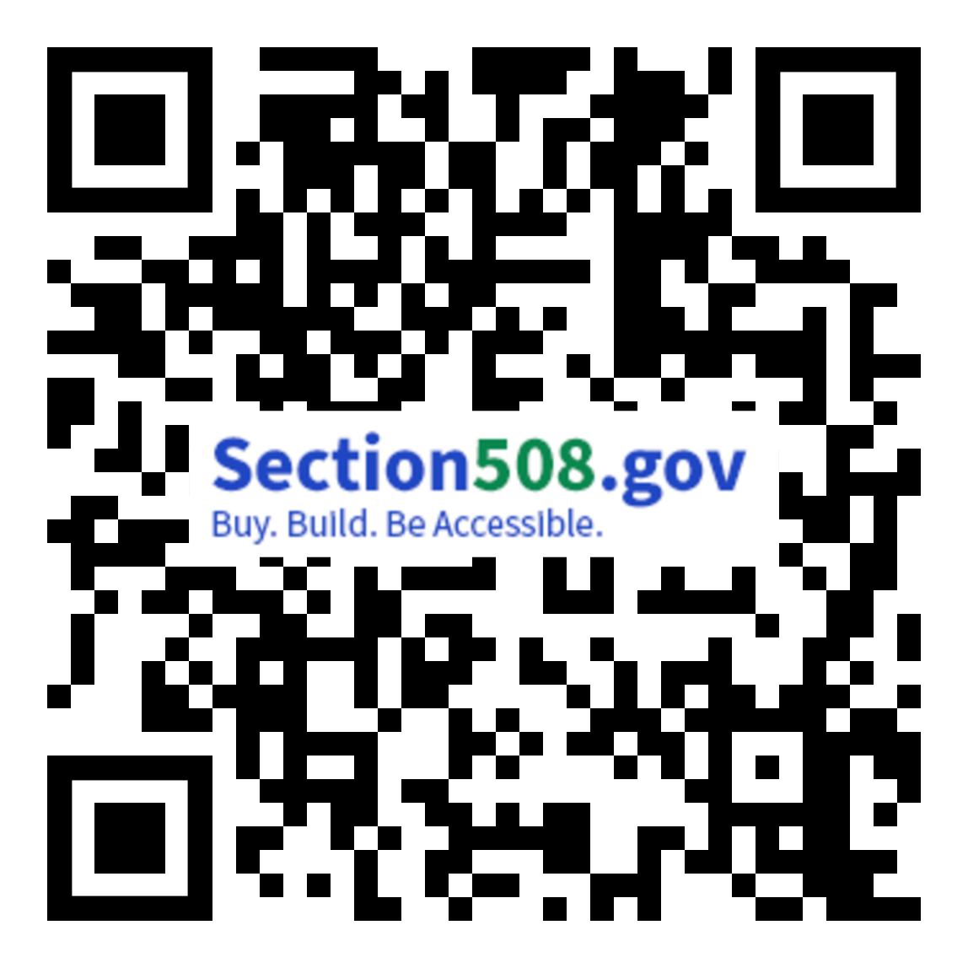
Questions
This and other presentations are available at:
Section508.gov/csun2024/
Notes:
Section508.gov/training/presentations-workshops/

Slide 16
CSUN Sessions and Presentation Files
FED Talk - Section 508 Activities Update by USAB & GSA Tuesday at 10:20 a.m. in Grand GH
Section 508 ICT Testing Baseline Portfolio Wednesday at 10:20 a.m. in Grand GH
OpenACR: The Future of Accessibility Conformance Reporting Wednesday at 11:20 a.m. in Grand GH
Birds of a Feather Thursday at 12:00 p.m. in Platinum 9-10 Ballroom
Analytical Approach to the Governmentwide Annual Assessment Thursday at 3:20 p.m. in Orange County 1-2
Introduction to the Accessibility Requirements Tool (ART) Thursday at 4:20 p.m. in Grand JK
Section508.gov/csun2024/

